Slide 1
MODULE II

Slide 2
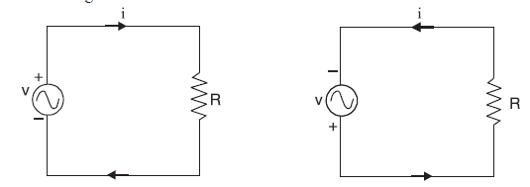
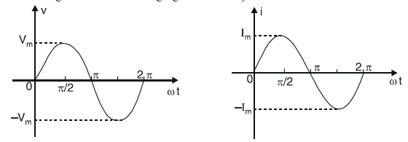
A.C. FUNDAMENTALS
Advantages
Alternating voltages can be stepped up or stepped down efficiently by means of a transformer.
A.c. motors (induction motors) are cheaper and simpler in construction than d.c. motors.
The switchgear (e.g. switches, circuit breakers etc.) for a.c. system is simpler than the d.c. system

Slide 3
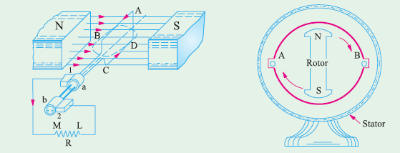
Generation of Alternating Voltages and Currents
An alternating voltage may be generated :
(i) by rotating a coil at constant angular velocity in a uniform magnetic field
or
(ii) by rotating a magnetic field at a constant angular velocity within a stationary coil
The value of the voltage generated depends, in each case, upon the number of turns in the coil, strength of the field and the speed at which the coil or magnetic field rotates. The first method is used for small a.c. generators while the second method is employed for large a.c. generators

Slide 4
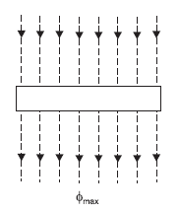

Equation of Alternating Voltage and Current
Consider a rectangular coil of n turns rotating in anticlockwise direction with an angular velocity
of ω rad/sec in a uniform magnetic field as shown in Fig
Let the time be measured from the instant the plane of the coil coincides with OX-axis. In this position of the coil, the flux linking with the coil has its maximum value φmax.
Let the coil turn through an angle θ (= ωt) in anticlockwise direction in t seconds. In this position, the maximum flux φmax acting vertically downward can be resolved into two perpendicular components viz.
Flux linkages of the coil
= No. of turns × Flux linking = n Φmax coswt
According to Faraday’s laws of electromagnetic induction, the e.m.f. induced in a coil is equal to the rate of change of flux linkages of the coil

Slide 5


The value of v will be maximum (call it Vm) when sin ωt = 1 i.e., when the coil has turned through 90º in anticlockwise direction from the reference axis.
Thus a coil rotating with a constant angular velocity in a uniform magnetic field produces a sinusoidal alternating e.m.f. If this alternating voltage (v = Vm sin ωt) is applied across a load, alternating current flows through the circuit which would also vary sinusoidally i.e., following a sine law. The equation of the alternating current is given by ;

Slide 6
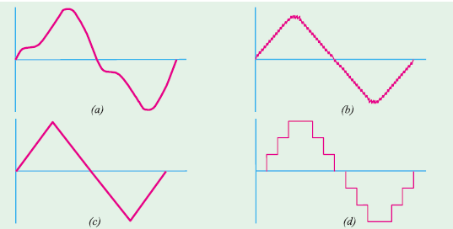
Simple Waveforms

Slide 7
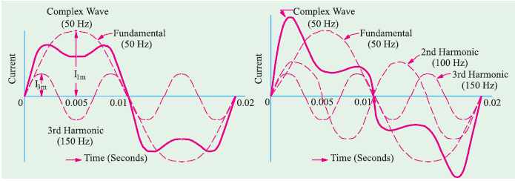
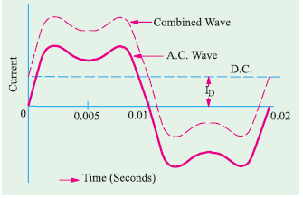
Complex Waveforms

Slide 8
Important A.C. Terminology
An alternating voltage or current changes continuously in magnitude and alternates in direction
at regular intervals of time. It rises from zero to maximum positive value, falls to zero, increases to
a maximum in the reverse direction and falls back to zero again
Waveform. The shape of the curve obtained by plotting the instantaneous values of voltage or current as ordinate against time as abcissa is called its waveform or waveshape.
Instantaneous value. The value of an alternating quantity at any instant is called instantaneous value.
Cycle. One complete set of positive and negative values of an alternating quantity is known as a cycle. A cycle can also be defined in terms of angular measure. One cycle corresponds to 360º electrical or 2π radians.
Alternation. One-half cycle of an alternating quantity is called an alternation. An alternation spans 180º electrical. The positive or negative half of alternating voltage is the alternation.
Time period. The time taken in seconds to complete one cycle of an alternating quantity is
called its time period. It is generally represented by T.
Frequency. The number of cycles that occur in one second is called the frequency (f) of the
alternating quantity. It is measured in cycles/sec (C/s) or Hertz (Hz). One Hertz is equal to 1C/s.
Amplitude. The maximum value (positive or negative) attained by an alternating quantity
is called its amplitude or peak value. The amplitude of an alternating voltage or current is designated
by Vm (or Em) or Im.

Slide 9


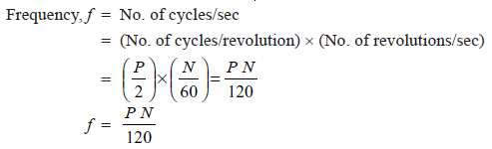
Time period and frequency.
Time taken to complete f cycles = 1 second
Time taken to complete 1 cycle = 1/f second
Angular velocity and frequency
the coil is rotating with an angular velocity of ω rad/sec in a uniform magnetic field. In one revolution of the coil, the angle turned is 2π radians and the voltage wave completes 1 cycle. The time taken to complete one cycle
is the time period T of the alternating voltage.
Frequency and speed
A coil rotating at a speed of N r.p.m. in the field of P poles. As the coil moves past successive north and south poles, one complete cycle is generated. Obviously, in one revolution of the coil, P/2 cycles will be generated

Slide 10


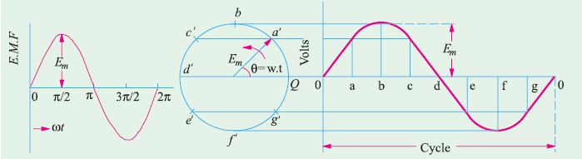
Different Forms of Alternating Voltage
Phase
Phase of a particular value of an alternating quantity is the fractional part of time period or cycle through which the quantity has advanced from the selected zero position of reference.

Slide 11
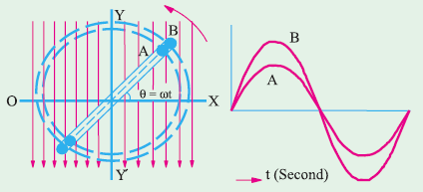

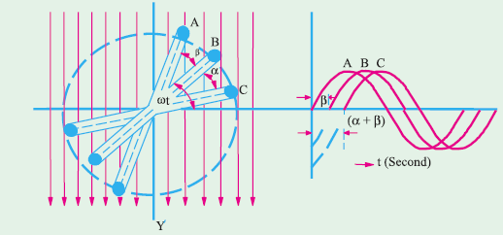
Phase Difference
when two alternating quantities of the same frequency have different zero points, they are said to have a phase difference.
B lags behind A by α and C lags behind A by (α + β) because they reach their maximum values later

Slide 12

‘lag’ or ‘lead’
A leading alternating quantity is one which reaches its maximum (or zero) value earlier as compared to the other quantity.
Similarly, a lagging alternating quantity is one which reaches its maximum or zero value later than the other quantity
B lags behind A by α and C lags behind A by (α + β) because they reach their maximum values later

Slide 13
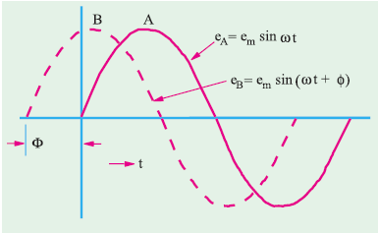

quantity B leads A by an angle Φ

Slide 14
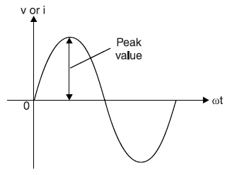

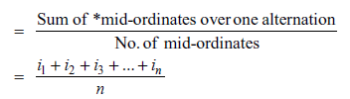
Peak Value
It is the maximum value attained by an alternating quantity. The peak or maximum value of an alternating voltage or current is represented by Vm
or Im.
Average Value
The average value of a waveform is the average of all its values over a period of time. That steady current which transfers across any circuit the same charge as is transferred by that alternating current during the same time.
In case of *symmetrical waves (e.g. sinusoidal voltage or current), the average value over one cycle is zero. It is because positive half is exactly equal to the negative half so that net area is zero. However, the average value of positive or negative half is not zero. Hence in case of symmetrical waves, average value means the average value of half-cycle or one alternation
In case of unsymmetrical waves (e.g. half-wave rectified voltage etc.), the average value is
taken over the full cycle.

Slide 15
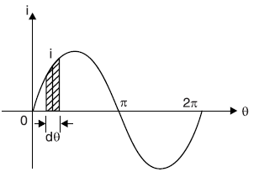
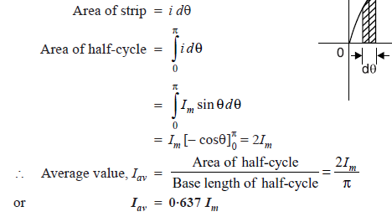
Average Value of Sinusoidal Current
Hence, the half-cycle average value of a.c. is 0·637 times the peak value of a.c.
For positive half-cycle, Iav = + 0·637 Im
For negative half-cycle, Iav = − 0·637 Im
Clearly, average value of a.c. over a complete cycle is zero. Similarly, it can be proved that for
alternating voltage varying sinusoidally, Vav = 0·637 Vm

Slide 16
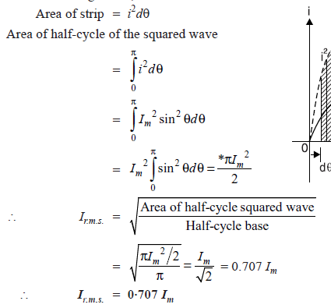
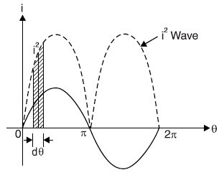

R.M.S.(Root Mean Square Value) or Effective Value
The effective or r.m.s. value of an alternating current is that steady current (d.c.) which when
flowing through a given resistance for a given time produces the same amount of heat as produced
by the alternating current when flowing through the same resistance for the same time.

Slide 17




Form Factor
The ratio of r.m.s. value to the average value of an alternating quantity is known as form factor i.e.
The form factor gives a measure of the “peakiness” of the waveform. The peakier the wave, the
greater is its form factor and vice-versa. For instance, a sine wave is peakier than a square wave. Similarly, a triangular wave is more peaky than a sine wave and has a form factor of 1·15.
Peak factor
The ratio of maximum value to the r.m.s. value of an alternating quantity is known as peak factor

Slide 18
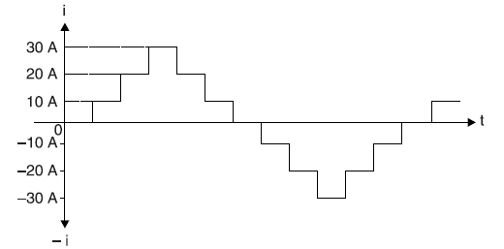
Q. An alternating voltage v = 200 sin 314t is applied to a device which offers an ohmic resistance of 20 Ω to the flow of current in one direction while entirely preventing the flow of current in the opposite direction. Calculate the current r.m.s. value, average value and form factor.
Q. A current has the following steady values in amperes for equal intervals of time changing instantaneously from one value to the next .0, 10, 20, 30, 20, 10, 0, −10, −20, −30, −20, −10, 0, etc. Calculate (i) average value (ii) r.m.s. value (iii) form factor and (iv) peak factor.

Slide 19
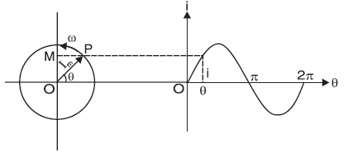
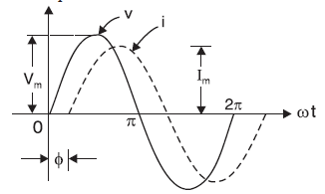


Phasor Representation of Sinusoidal Quantities

Slide 20
Representing Phasors

Slide 21


Representation
$$V_{m}$$
Polar Form
Φ
Rectangular Form
A + j B
Exponential Form
Vm $e^{−j∅}$

Slide 22
Three resistors in parallel take the following currents :
i1 = 20 sin 314 t ;
i2 = 30 sin (314 t − π/4) ;
i3 = 40 Sin (314 t + 2π/3)
Find the expression for the resultant current.
its r.m.s. value and frequency

Slide 23
A circuit consists of three loads in series ; the voltage across these loads are given by the following relations measured in volts :
v1 = 50 sin ω t ;
v2 = 25 sin (ω t + 60º)
v3 = 30 sin (ω t − 45º)
Calculate the supply voltage giving the relation in similar form.

Slide 24
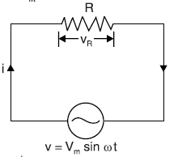



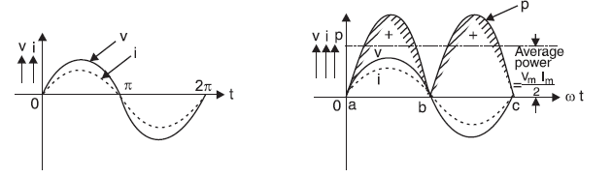
A.C. Circuit Containing Resistance Only
Let the alternating voltage be given by the equation
The value of i will be maximum (i.e. Im) when sin ωt = 1.

Slide 25

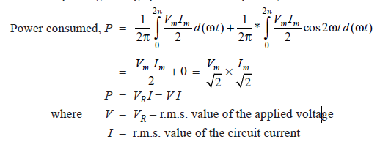
Power
Thus power consists of two parts viz. a constant part (VmIm/2) and a fluctuating part (VmIm/2) cos2ωt.
Since power is a scalar quantity, average power over a complete cycle is to be considered.

Slide 26
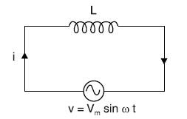
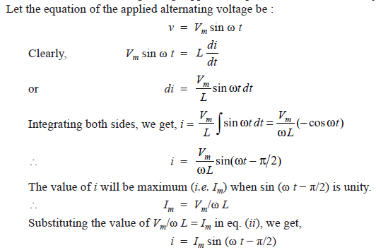
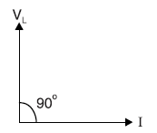
A.C. Circuit Containing Pure Inductance Only

Slide 27
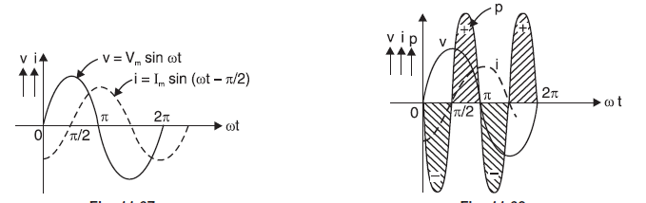

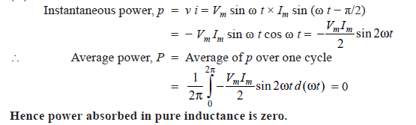
Inductive reactance
Power
In a resistance, current and p.d. are in phase and power is absorbed. In an inductance, current and p.d. are 90° out of phase and there is no net power consumed

Slide 28
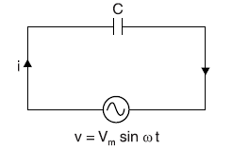
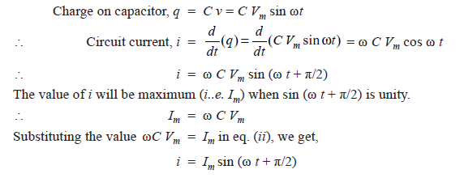
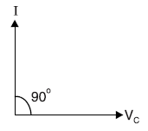
A.C. Circuit Containing Capacitance Only
Let at any instant i be the current and q be the charge on the plates.

Slide 29
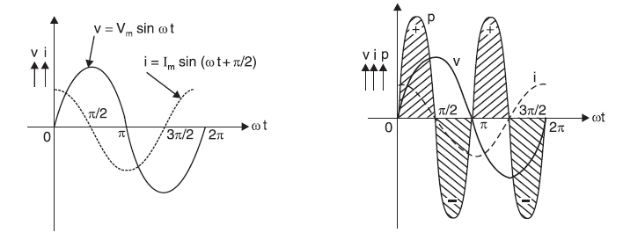


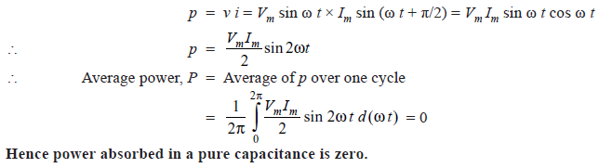
Capacitive reactance
Power

Slide 30
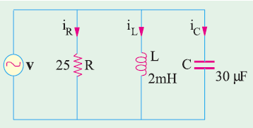
The voltage applied across 3-branched circuit of Fig. is given by v = 100 sin (5000t + π/4). Calculate the branch currents and total current.

Slide 31
The current in a circuit is given by (4.5 + j12) A when the applied voltage is (100 + j150) V. Determine (i) the magnitude of impedance and (ii) phase angle.

Slide 32
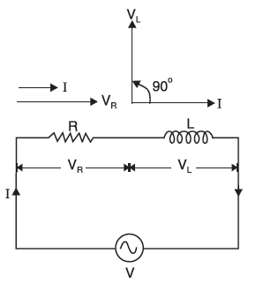
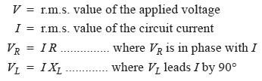
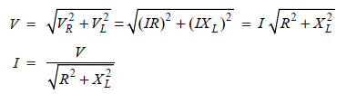
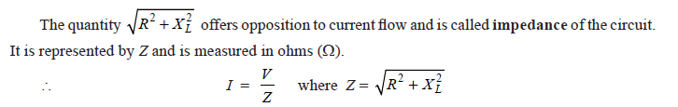
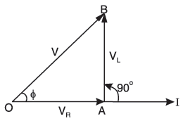
R- L Series A.C. Circuit
The applied voltage V is the phasor sum of

Slide 33

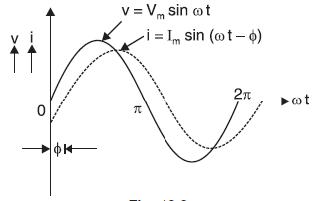

The value of phase angle Φ is
In an inductive circuit, current lags behind the applied voltage. The angle of lag (i.e. Φ) is greater than 0° but less than 90°. It is determined by the ratio of inductive reactance to resistance (tan Φ = XL/R) in the circuit. The greater the value of this ratio, the greater will be the phase angle Φ and vice-versa.

Slide 34
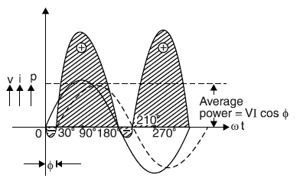
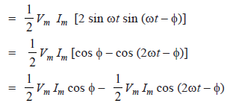


Power
The term cos Φ is called power factor of the circuit and its value is given by
This is expected because power is consumed in resistance only; inductance does not consume
any power.

Slide 35
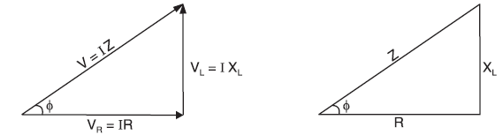
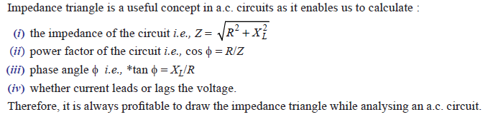
Impedance Triangle

Slide 36

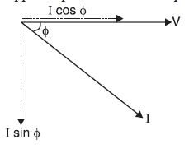

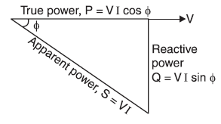

Apparent power (S). The total power that appears to be transferred between the source and load is called apparent power. It is equal to the product of applied voltage (V) and circuit current (I) i.e.
Apparent power, S = V × I = VI = (P+jQ)
It is measured in volt-ampers (VA).
Apparent power has two components viz true power and reactive power.
True power (P). The power which is actually consumed in the circuit is called
true power or active power. The product of voltage (V) and component of total current in phase with voltage (I cos Φ) is equal to true power i.e.
It is measured in watts (W). The component I cos Φ is called in-phase component or wattful component because it is this component of total current which contributes to true power (i.e. VI cos Φ). It may be noted that it is the true power which is used for producing torque in motors and supply heat, light etc. It is used up in the circuit and cannot be recovered.

Slide 37

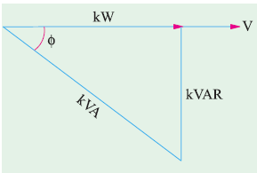
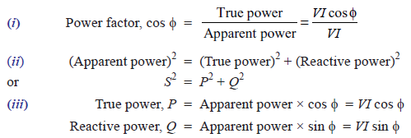
Reactive power (Q). The component of apparent power which is neither consumed nor does any useful work in the circuit is called reactive power. The power consumed (or true power) in L and C is zero because all the power received from the source in one quarter-cycle is returned to the source in the next quarter-cycle. This circulating power is called reactive power
The product of voltage (V) and component of total current 90° out of phase with voltage (I sin Φ) is equal to reactive power i.e.
It is measured in volt-amperes reactive (VAR). The component I sin Φ is called the reactive component (or wattless component) and contributes to reactive power (i.e. VI sin Φ). It does no useful work in the circuit and merely flows back and forth in both directions in the circuit. A wattmeter does not measure the reactive power.
Power triangle

Slide 38
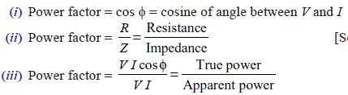
Power Factor
The power factor (i.e. cos Φ ) of a circuit can be defined in one of the following ways :
In a resistor, the current and voltage are in phase i.e. Φ = 0°. Therefore, power factor of a pure resistive circuit is
cos 0° = 1. Similarly, phase difference between voltage and current in a pure inductance or capacitance is 90°. Hence power factor of pure L or C is zero. This is the reason that power consumed by pure L or C is zero. For a circuit having R, L and C in varying proportions, the value of power factor will lie between 0 and 1.
power factor can never have a value greater than 1.
Power factor expressed as:
‘lagging’ or ‘leading’
Percentage-0.8 lagging power factor may be expressed as 80% lagging

Slide 39
Apparent Power → True power
→ reactive power
True power should be large → does useful work in the circuit
So reactive power should be small
Smaller the phase angle Φ → greater the power factor → smaller the reactive power component
Thus power factor of a circuit is a measure of its effectiveness in utilising the apparent power drawn by it. The greater the power factor of a circuit, the greater is its ability to utilise the apparent power

Slide 40

Q-factor of a Coil
The ratio of the inductive reactance (XL) of a coil to its resistance (R) at a given frequency is known as Q-factor of the coil at that frequency i.e.,
The Q-factor is used to describe the quality or effectiveness of a coil. A coil is usually designed
to have high value of L compared to its resistance R. The greater the value of Q-factor of a coil, the greater is its inductance (L) as compared to its resistance (R).

Slide 41
A current of 10 A at a voltage of 200 V and its power factor is 0.8 lagging. Find Apparent power, true power and reactive power.
The reactive power does no useful work, it merely flows into and out of the circuit periodically. In fact, reactive power is a liability on the source because the source has to supply the additional current
(i.e. I sin Φ) to provide for this power

Slide 42
In an R-L series circuit, R = 10 Ω and XL = 8.66 Ω. If current in the circuit is (5 – j 10)A, find (i) the applied voltage (ii) power factor and (iii) active power and reactive power

Slide 43
In a given R–L series circuit, R = 35 Ω and L = 0.1 H. Find (i) current through the circuit (ii) power factor if a 50 Hz frequency, voltage V = 220 ∠ 30°V is applied across the circuit.

Slide 44

In the circuit, applied voltage V is given by (0 + j 10) V and the current is (0.8 + j 0.6) A. Determine the values of R and X also indicate if X is inductive or capacitive.

Slide 45





R-C Series A.C. Circuit

Slide 46





The value of phase angle Φ is
Power

Slide 47
A capacitor of capacitance 79·5 μ F is connected in series with a non-inductive resistance of 30 Ω across 100 V, 50 Hz supply. Find (i) impedance (ii) current (iii) phase angle and (iv) equation for the instantaneous value of current.

Slide 48





R-L-C Series A.C. Circuit
The circuit can either be effectively inductive or capacitive depending upon which voltage drop (VL or VC) is predominant

Slide 49




Slide 50
A coil of resistance 12 Ω and inductive reactance of 25 Ω is connected in series with a capacitive reactance of 41 Ω. The combination is connected to a supply of 230 V, 50Hz. Using phasor algebra, find (i) circuit impedance (ii) current and (iii) power consumed.
Ans: Z = (12-16j)Ω; I = (6.92+9.18j)A; P = 1591.8W

Slide 51

In the circuit shown in Fig. 13.20, calculate (i) current (ii) voltage drops V1, V2 and V3
Ans: I = (6.33+2.26j)A; V1 = (18.54+28.06j)V; V2 = (56.22-36.97j)V; V3 = (25.34+ 9.06j)V

Slide 52
A 230 V, 50 Hz a.c. supply is applied to a coil of 0.06 H inductance and 2.5Ω resistance connected in series with a 6·8 μF capacitor. Calculate (i) impedance (ii) current (iii) phase angle between current and voltage (iv) power factor and (v) power consumed.
Ans: Z = (2.5-449.26j)Ω; I = (2.85+0.511j)A; P =0.6830W

Slide 53
A 230 V, 50 Hz a.c. supply is applied to a coil of 0.06 H inductance and 2.5Ω resistance connected in series with a 6·8 μF capacitor. Calculate (i) impedance (ii) current (iii) phase angle between current and voltage (iv) power factor and (v) power consumed.
Ans: Z = (2.5-449.26j)Ω; I = (2.85+0.511j)A; P =0.6830W

Slide 54

Ans: I1 = (4.65-10.86j) A; I2 = (15+0j)A; I = (19.65-10.85j)A; V = (45-45j)V

Slide 55

Two impedances given by Z1 = (10 + j 5) and Z2 = (8 + j 6) are joined in parallel and connected across a voltage of V = 200 + j0. Calculate the circuit current, its phase and the branch currents. Draw the vector diagram.

Slide 56

If the voltmeter in Fig. reads 60 V, find the reading of the ammeter.

Slide 57

Calculate (i) total current and (ii) equivalent impedance for the four-branched circuit of Fig.

Slide 58
Polyphase Circuits
If the generator is arranged to have two or more separate windings displaced from each other by equal electrical angles, it is called a Polyphase generator and will produce as many independent voltages as the number of windings or phases.
The 3-phase system is by far the most popular because it is the most efficient of all the supply systems.

Slide 59




single-phase alternator
two-phase alternator
a1 and b1 are 90° apart
3-phase alternator
a1, b1 and c1 are 120° apart

Slide 60
Reasons for the Use of 3-phase System
1. Constant power
In a single-phase circuit, the instantaneous power varies sinusoidally from zero to a peak value at twice the supply frequency. However, in a balanced 3-phase system, the power supplied at all instants of time is constant. Because of this, the operating characteristics of 3-phase apparatus, in general, are superior to those of similar single-phase apparatus.
2. Greater output
The output of a 3-phase machine is greater than that of a single-phase machine for a given volume and weight of the machine. In other words, a 3-phase machine is smaller than a single-phase machine of the same rating.
3. Cheaper
The three-phase motors are much smaller and less expensive than single-phase motors because less material (copper, iron, insulation) is required. Moreover, 3-phase motors are self-starting i.e. they do not require any special provision to get them started.

Slide 61
4. Power transmission economics
Transmission of electric power by 3-phase system is cheaper than that of single-phase system, even though three conductors are required.
5. Three-phase rectifier service
Rectified 3-phase voltage is smoother than rectified single phase voltage. As a result, it is easier to filter out the ripple component of 3-phase voltage than that of a single-phase voltage. This is especially useful where large a.c. power is to be converted into steady d.c. power e.g. radio and television transmitters.
6. Miscellaneous advantages
(i) A 3-phase system can set-up a rotating uniform magnetic field in stationary windings. This
cannot be done with a single-phase current.
(ii) The 3-phase motors are more efficient and have a higher power factor than single phase
motors of the same capacity.

Slide 62



Elementary Three-Phase Alternator
the sum of the three e.m.f.s at every instant is zero.

Slide 63


Er= 2E cos 60° = E = -Ec
Phase sequence
The order in which the voltages in the three phases (or coils) of an alternator reach their maximum positive values is called phase sequence or phase order.
Since the alternator can be rotated in either clockwise or anticlockwise direction, there can be only two possible
phase sequences.

Slide 64

Naming the phases
Red (R), yellow (Y) and blue (B)
By convention, sequence RYB is taken as positive and RBY as negative
Double-subscript notation
VRY indicates a voltage V between points R and Y with point R being positive w.r.t. point Y
Interconnection of Three Phases
(i) Star or Wye (Y) connection
(ii) Mesh or Delta (Δ) connection

Slide 65

In Y-connection
Neutral point/ star point
If a neutral conductor exists, the system is called 3-phase, 4-wire system.
If there is no neutral conductor, it is called 3-phase, 3-wire system.
In Δ-connection
No neutral point exists and only 3-phase, 3-wire system can be formed
Star or Wye Connected System
phase voltage
line voltage
phase currents
line currents
Balanced load-load in each phase of the alternator has the same impedance and power factor
The 3-wire star-connected system is used for balanced loads → No neutral conductor needed
4-wire star-connected system- Unbalanced load → neutral conductor provides the return path

Slide 66
The three phase voltages (i.e. ERN, EYN, and EBN) are equal in magnitude but displaced 120°
from each other. The same is true for line voltages (i.e. VRY, VYB and VBR)→Balanced supply system.
Thus Y-connected balanced supply system enables us to use two voltages viz. phase voltage and line voltage.
For balanced loads, all line currents (or phase currents) are equal in magnitude but displaced 120° from each other
For 3-phase, 4-wire star-connected system, the current IN in the neutral wire is the phasor sum of the three line currents.

Slide 67

3-phase loads
(i) star-connected load
(ii) delta-connected load
The 3-phase load (star or delta connected) is said to be balanced if load in each phase is the same (i.e. load in each phase has the same impedance and power factor).
Balanced 3-phase system
(i) It should have balanced 3-phase supply.
(ii) It should have balanced 3-phase or single phase loads on the balanced 3-phase supply.
(iii) It should have equal active power and equal reactive power flow in each phase.

Slide 68



Voltages and Currents in Balanced Y-Connected Supply System
The r.m.s. values of the e.m.f.s generated in the three phases are ERN, EYN and EBN
phasor difference
phasor difference
phasor difference

Slide 69


1. Relation between line voltage and phase voltage
Considering the lines R and Y, the line voltage VRY is equal to the phasor difference of ERN and EYN.
equal in magnitude (= Eph) and are 60° apart.
Hence in a balanced 3-phase Y-connected supply system :
(i) Line voltage, VL =$\sqrt{3}$ Eph ... in magnitude
(ii) All line voltages are equal in magnitude (i.e. = $\sqrt{3}$Eph ) but displaced 120° from one another
(iii) Line voltages are 30° ahead of their respective phase voltages.

Slide 70


2. Relation between line current and phase current
Current in a line conductor is the same as that in the phase to which the line conductor is connected.
For a balanced load, all the phase currents are equal in magnitude but displaced 120° from one another
Φ is the angle between phase voltage and the corresponding phase current.
The angle between the line current and the corresponding line voltage (IR and VRY) is (30°+Φ)
If the balanced load has a leading power factor of cos Φ , then the angle between the line current and the corresponding line voltage will be (30°- Φ)
Hence in a balanced 3-phase Y-connected supply system :
(i) Line current, IL = Iph
(ii) All the line currents are equal in magnitude (i.e. = Iph) but displaced 120° from one another.
(iii) The angle between the line currents and the corresponding line voltages is 30° ± Φ ; + if p.f. is lagging and – if it is leading.

Slide 71




3. Power
For a balanced load, the power consumed in each load phase is the same.
For a balanced load, the three line currents have the same magnitude (say IL) but differ in phase by 120°.
Therefore, for balanced loads, current in the neutral wire is zero and no neutral conductor is required, resulting in the saving of conductor material

Slide 72

Three coils, each having a resistance of 20 Ω and an inductive reactance of 15 Ω, are connected in star to a 400 V, 3-phase, 50 Hz supply. Calculate (i) the line current (ii) power factor and (iii) power supplied.

Slide 73
A balanced star connected load is supplied from a symmetrical three phase, 400V and 50Hz. The current in each phase is 30A and lag 30 degree behind the phase voltage. Find:
Phase voltage
Resistance and reactance per phase
Load inductance per phase
Total power consumed
Reactive volt ampere
Total volt ampere
Draw the phasor diagram showing the current and voltage

Slide 74
A balanced three phase star connected load of 120KW takes a leading current of 100A, when connected across three phase, 3.3KV and 50Hz supply. Determine the impedance, resistance, capacitance and power factor of load.

Slide 75

Delta (Δ) or Mesh Connected System
no neutral exists
Voltages and Currents in Balanced Δ Connected Supply System
(i) Line voltage and phase voltage
Only one phase is included between any two lines. Hence magnitude of voltage between any two lines (i.e. line voltage) is equal to the magnitude of phase voltage
The three phase voltages (= line voltages) are equal in magnitude but displaced 120° from one another.

Slide 76




(ii) Line current and phase current
Current in any line is equal to the phasor difference of the currents in the two phases connected to that line. Therefore, magnitude of line currents is different from the magnitude of phase currents.
For balanced load, the three phase currents (IR, IY and IB) are equal in magnitude but displaced 120° from one another

Slide 77




(iii) Power

Slide 78
Advantages of Delta Connection
Most suitable for rotary convertors
Most of the 3-phase loads are Δ-connected rather than Y-connected.
Most of 3-phase induction motors are delta-connected.
Advantages of Star Connection
A star-connected alternator will require less number of turns of the winding than a Δ-connected alternator.
For the same line voltage, a star-connected alternator requires less insulation than a delta connected
alternator.
This permits to use two voltages viz, phase voltages as well as line voltages.
In star connection, the neutral point can be earthed.

Slide 79
Three similar coils each having a resistance of 5Ω and an inductance of 0.02H are connected in delta to a 440V, 3-phase, 50Hz supply. Calculate the line current and total power absorbed.

Slide 80
A delta connection balanced load is connected to a three phase, 400V supply. The load power factor is 0.8 lagging. The line current is 34.64A. Find resistance, total power, total reactive volt ampere, total volt ampere. Draw the phasor diagram.

Slide 81
The three equal impedances, each of 10<60 degree ohms are connected in star across three voltages, 400V and 50Hz supply. Calculate
Line voltage and phase voltage
Line current and phase current
Power factor and active power consumed
Also calculate the active power consumed if the three impedances are connected in delta to the same source of supply.

